Slide 1
Considering
Categorical Data

Slide 2
Contingency Tables
A table that summarizes data for two categorical variables is called a contingency table.

Slide 3
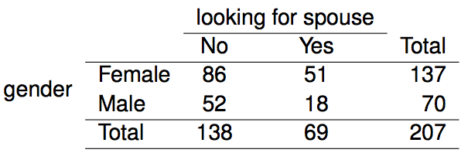
Contingency Tables
A table that summarizes data for two categorical variables is called a contingency table.
The contingency table below shows the distribution of students' genders and whether or not they are looking for a spouse while in college.

Slide 4
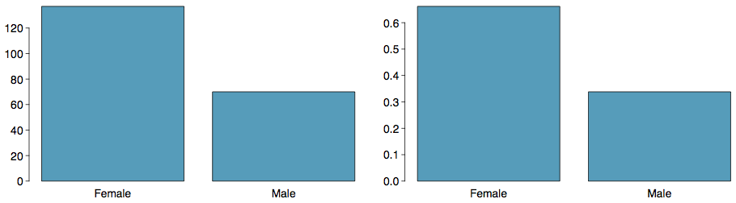
Bar Plots
A bar plot is a common way to display a single categorical variable. A bar plot where proportions instead of frequencies are shown is called a relative frequency bar plot.

Slide 5
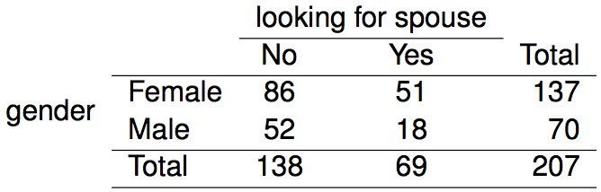
Choosing the
Appropriate Proportion
Does there appear to be a relationship between gender and whether the student is looking for a spouse in college?

Slide 6
Choosing the
Appropriate Proportion
Does there appear to be a relationship between gender and whether the student is looking for a spouse in college?
To answer this question we examine the row proportions:

Slide 7
Choosing the
Appropriate Proportion
Does there appear to be a relationship between gender and whether the student is looking for a spouse in college?
To answer this question we examine the row proportions:
% Females looking for a spouse: 51 / 137 ~ 0.37
% Males looking for a spouse: 18 / 70 ~ 0.26

Slide 8
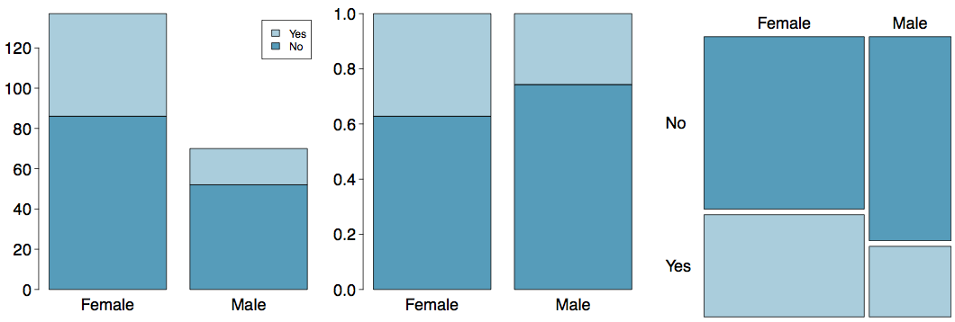
Segmented Bar and Mosaic Plots
What are the differences between the three visualizations shown below?

Slide 9
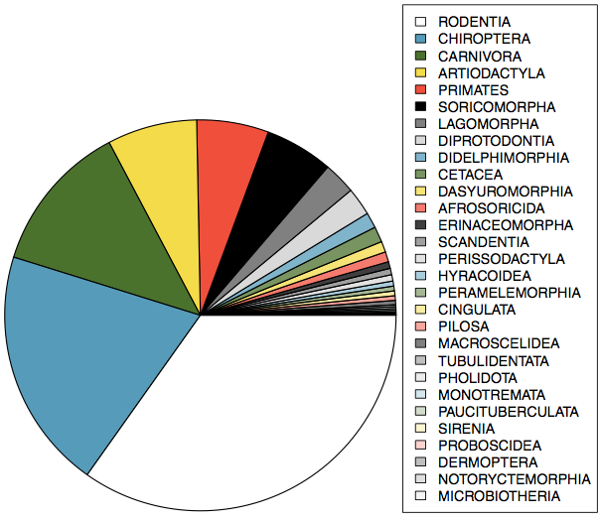
Pie Charts
Can you tell which order encompasses the lowest percentage of mammal species?
http://www.bucknell.edu/msw3

Slide 10
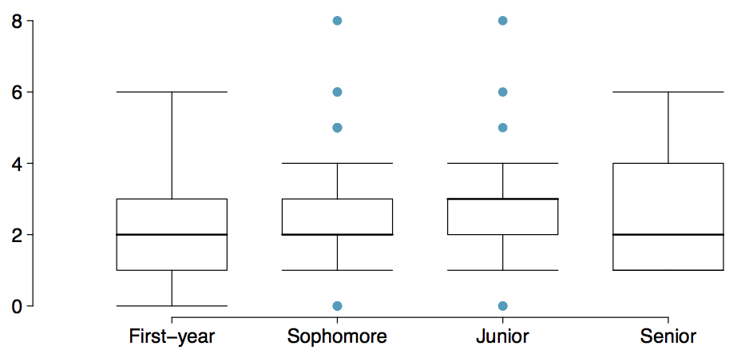
Comparing Numerical Data
Across Groups
Does there appear to be a relationship between class year and number of clubs students are in?

